Slide 1
Advanced Dashcam Assistance System
Group 2
110064533 陳劭珩
111061537 洪子晴
111062574 徐瑞憫
111064537 林亭君
111065515 鄭皓姿

Slide 2
Outline
Introduction
System Architecture
Technology
Global Market Analysis
Reference

Slide 3
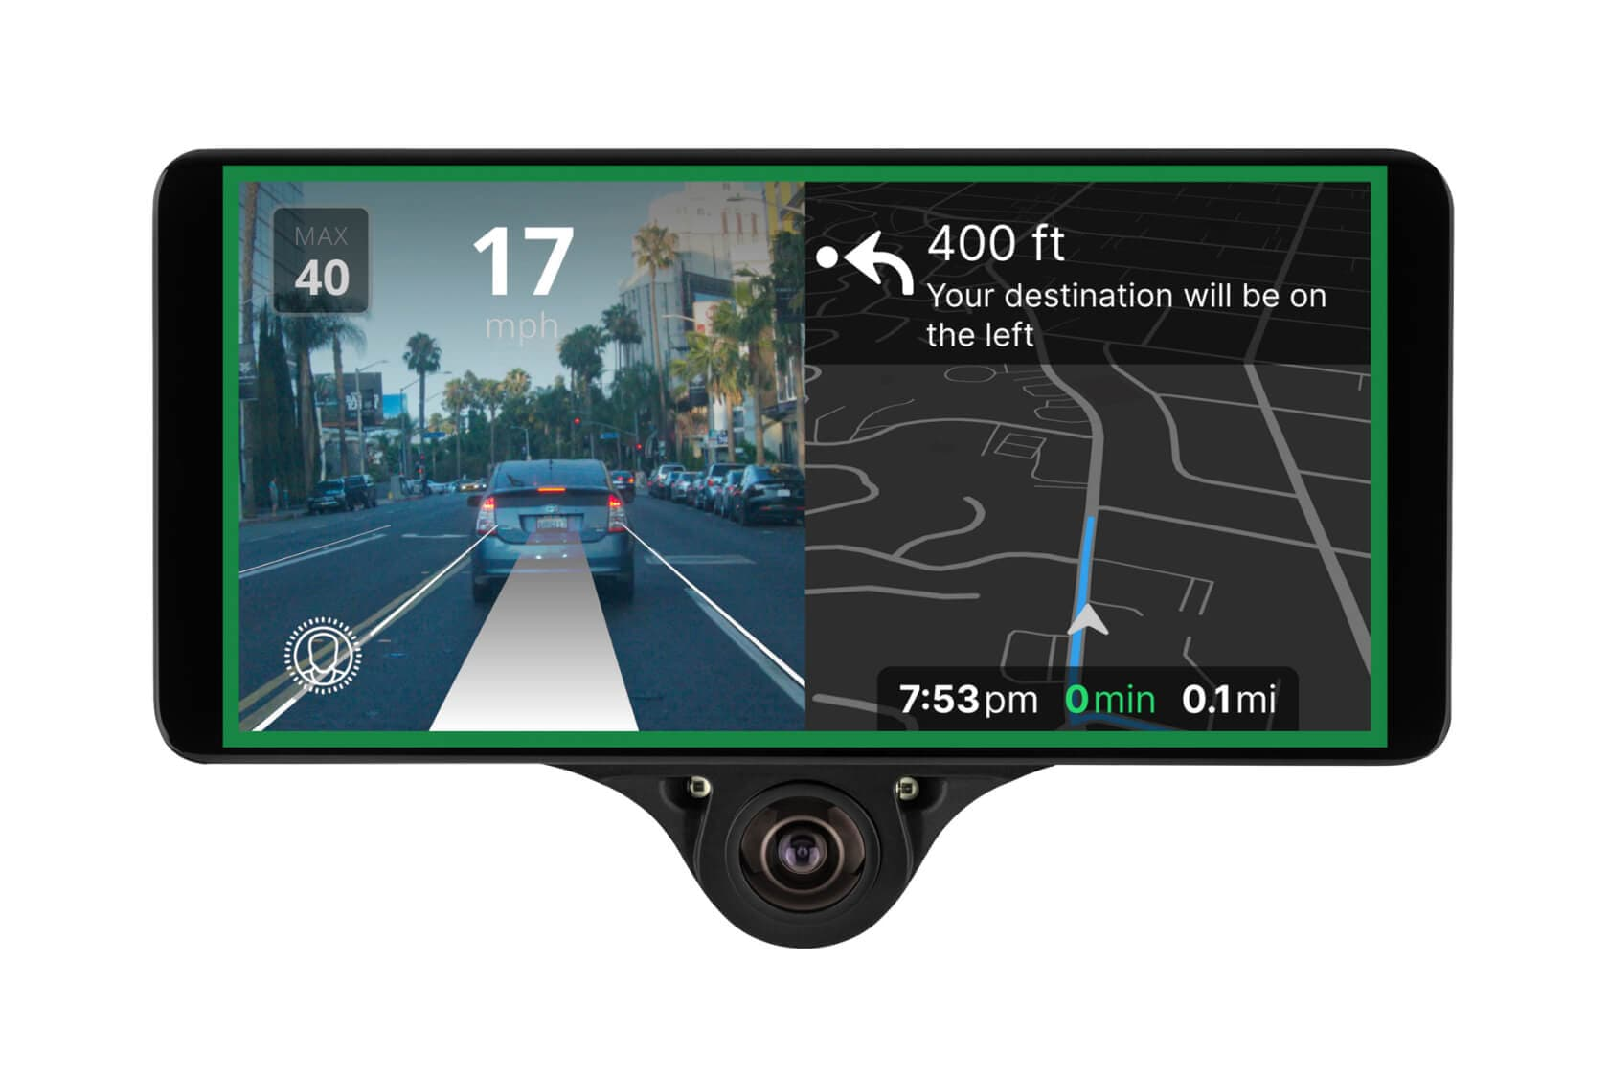
Outline
Introduction
Motivation
Application Scenario
System Architecture
Technology
Global Market Analysis
Reference

Slide 4
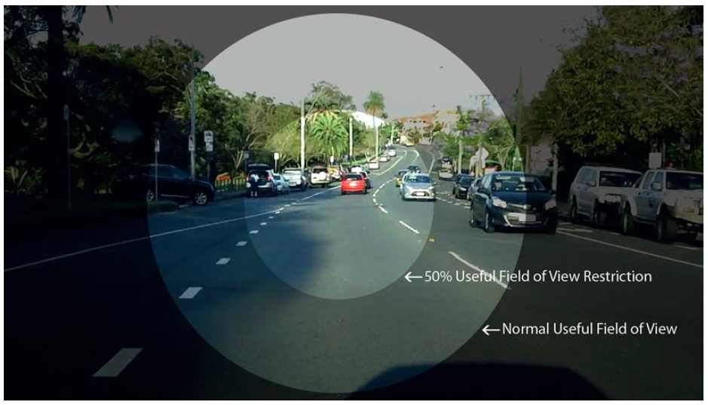
Motivation
Driving Condition
There are numerous things to pay attention while driving
Useful Visual Field of View (UFOV) studies in driving ability
Driver’s attention and concentration
Target User
Ordinary drivers with safety consciousness
Car rental company
Logistics
Uber
Driving school

Slide 5


Application Scenario
Driving Assistance
Assist ordinary drivers
Particularly helpful for new drivers
Reduce fatigue while driving
Prevent from fatigue drivers and drunk drivers
Improve the safety of all road users
Detect drunk driving
Detect fatigue driving
Detect distracted driving

Slide 6
Outline
Introduction
System Architecture
Features
System Diagram
Data Flow Diagram
System Specification
Technology
Global Market Analysis
Conclusion
Reference

Slide 7




Features – Focus Reminder System
Inner system
A pressure sensor on the steering wheel to prevent fatigue driving
An alcohol gas detection to prevent drunk driving
An inner cam and a radar to detect driver and passenger behavior
Outer system
Driving assiatance
Vision for object detection and lane detection
Radar for object detection that provide range and doppler estimation

Slide 8
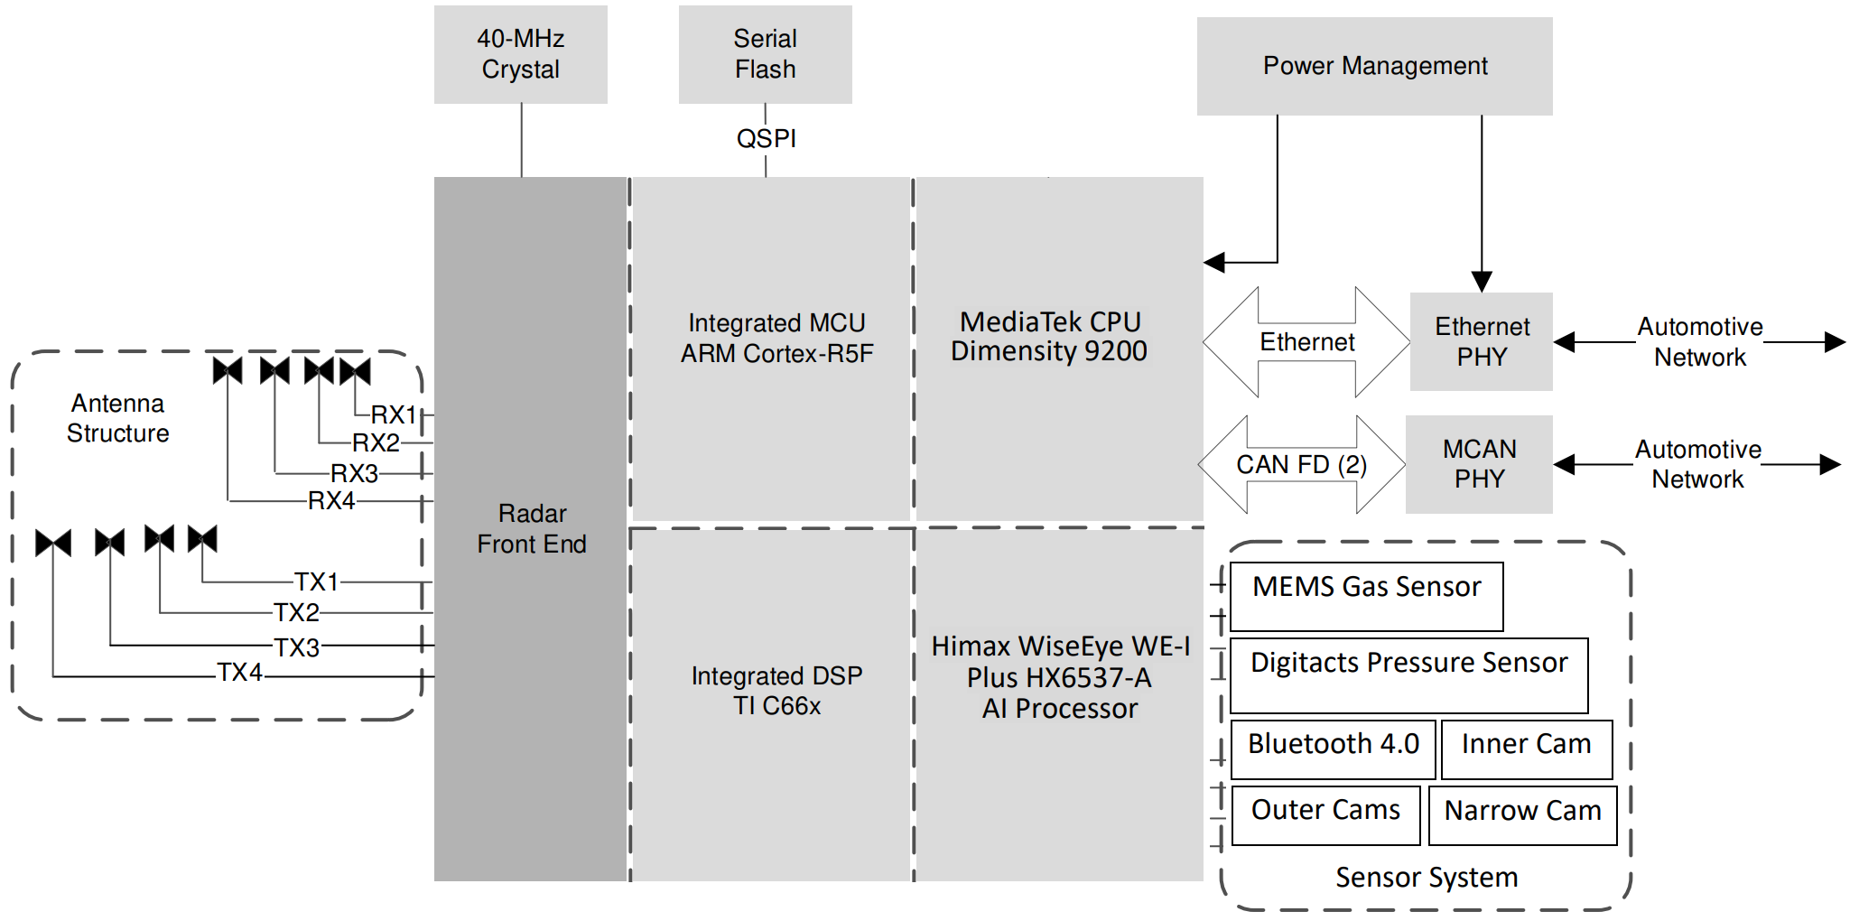
System Diagram

Slide 9
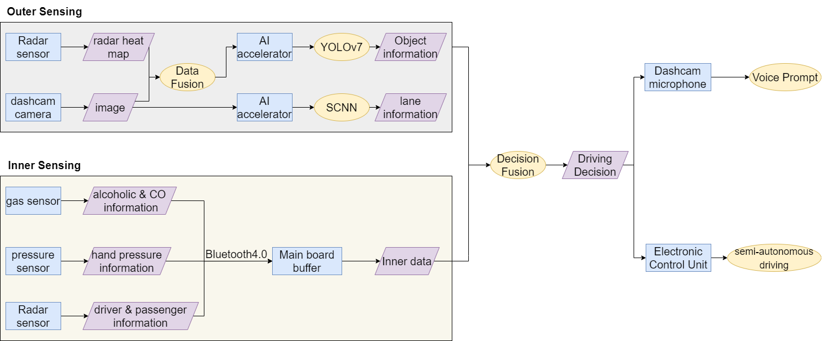
Data Flow Diagram

Slide 10
System Specification - 1
Main Processor
MediaTek Dimensity 9200
Radar Processor
ARM Cortex-R5F
TI DSP C66x
Camera
Three 1080p cameras w/ 120 dB of dynamic range: dual-cam 360° vision
One narrow camera to see far-away objects
Storage
32 GB built-in storage
1TB Samsung 980 NVMe SSD

Slide 11
System Specification - 2
Connectivity
Cellular Technologies
FR1: Sub-6GHz
FR2: mmWave
LTE, GSM
Wi-Fi
Bluetooth
High-Precision GNSS
GPS
BeiDou
Glonass
Nightvision
IR LEDs for interior night-vision monitoring
Radar Sensor

Slide 12
Outline
Introduction
Motivations
System Architecture
Technology
Sensor
Main Chip
Bluetooth Low Energy 4.0
Global Market Analysis
Reference

Slide 13
Radar Sensor
TI AWR 2944
76-81 GHz mmwave radar sensor
four-transmit four-receive antenna
On-chip C66x DSP core and ARM Cortex-R5F controller
On-chip hardware accelerator for FFT
Number of receivers | 4
Number of transmitters | 4
ADC sampling rate (Max) (MSPS) | 37.5
Interface type | 2 CAN-FD, Ethernet, I2C
DSP | C66x DSP 360MHz
Hardware accelerators | Radar hardware accelerator
Rating | Automotive
Operating temperature range (C) | -40 to 140
Power supply solution | LP87745-Q1
Security | Cryptographic acceleration, Device identity/keys, Secure boot, Secure software update, Software IP protection, Trusted execution environment

Slide 14
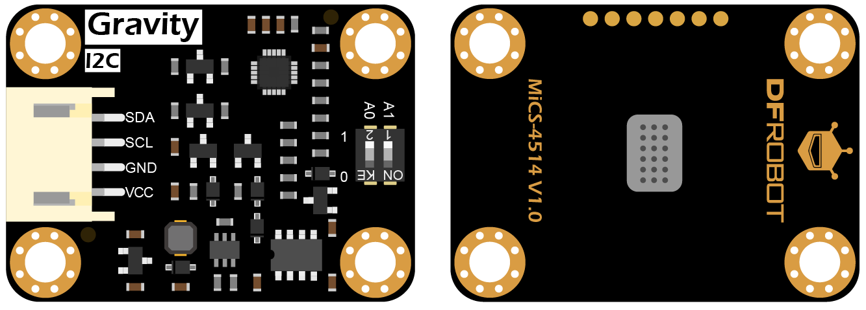
Gas Sensor
Gravity: MEMS Gas Sensor
Gas conentration sensor from DFRobot
Support the detection of CO, C2H5OH (Alcohol), NO2, H2, NH3, CH4
Low power and compatible with Arduino, Raspberry Pi...... using I2C output

Slide 15
Gas Sensor
Specification
Operating Voltage (V) | 3.3 ~ 5.5 (DC)
Power Dissipation (W) | 0.45 (5V)
Output Signal | I2C (0 ~ 3V)
Operating Temperature (°C) | -30 to 85
Operating Humidity | 5% ~ 95% RH (No Condensation)
Storage Temperature (°C) | -40 to 85
Lifespan | > 2years (in the air)
Circuit Board Size (mm^2) | 27*37
Mounting Hole Size (mm) | Inner Diameter: 3.1 / Outer Diameter: 6
Measuring Range:
1 – 1000 (ppm) (Carbon monoxide CO)
10 – 500 (ppm) (Ethanol C2H5OH)
0.05 – 10 (ppm) (Nitrogen dioxide NO2)
1 – 1000 (ppm) (Hydrogen H2)
1 – 500 (ppm) (Ammonia NH3)
>1000 (ppm) (Methane CH4)

Slide 16
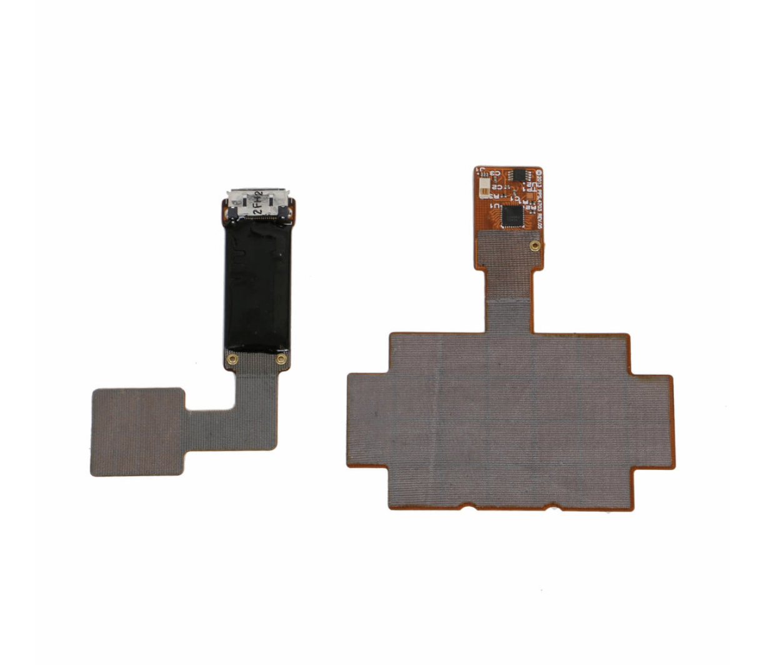
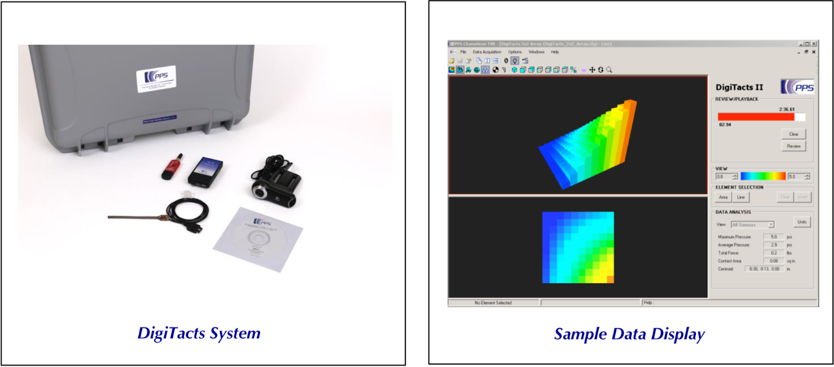
Pressure Sensor
Digitacts
High performance embedded tactile sensors from Pressure Profile Systems (PPS)
Sensitive tactile sensors can be used on almost any geometry surface
Bluetooth wireless technology and SPI or I2C serial digital output
Chameleon Visualization Software (Easy to use, high-quality visualization...)

Slide 17
Pressure Sensor
Specification
Sensor
Electronics
Pressure Range (psi) | 5, 20, 40
Pressure Sensitivity | 0.2%
Linearity | 99.7%
Signal to Noise Ratio (SNR) | 700
Contact Surface Material | Cloth and Polyimide
Sensor Thickness (mm) | 0.5
Cable Length(m) | 1.5
Operating Temperature (°C) | -20 to 100
Sampling Rate (Hz) | 30-100
Computer Interface | Bluetooth
Input Voltage | 5V
Input Power | 2.5W
ADC Resolution | 16 bits
Enclosure Size (cm) | 75x40x12.8
Weight (g) | 55

Slide 18
Main Chip - SoC
CPU
MediaTek Dimensity 9200
Radar Processor
ARM Cortex-R5F
DSP
TI DSP C66x
AI Processor
Himax WiseEye WE-I Plus HX6537-A
Radar
processor
CPU
DSP
AI
processor

Slide 19
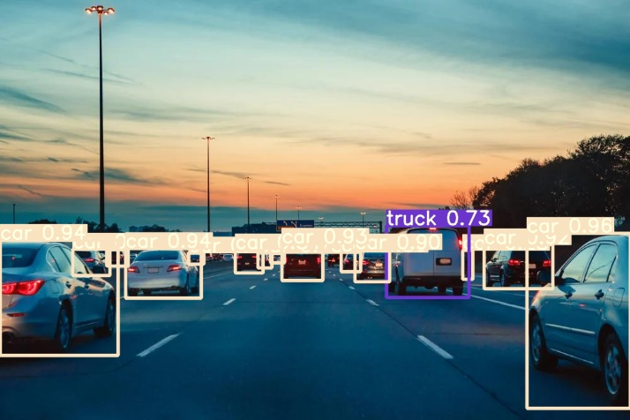
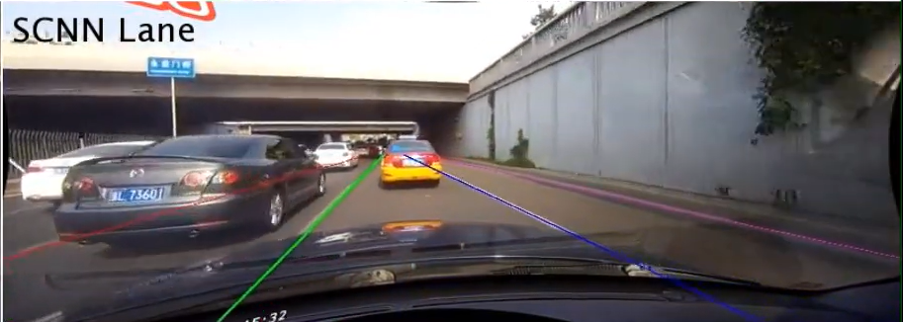
AI Processor
AI accelerator is a class of specialized hardware accelerator or computer system designed to accelerate machine learning applications.
We use AI Processor to accelerate
YOLOv7 for Object Detection
SCNN for Lane Detection
Object Detection
Lane Detection

Slide 20
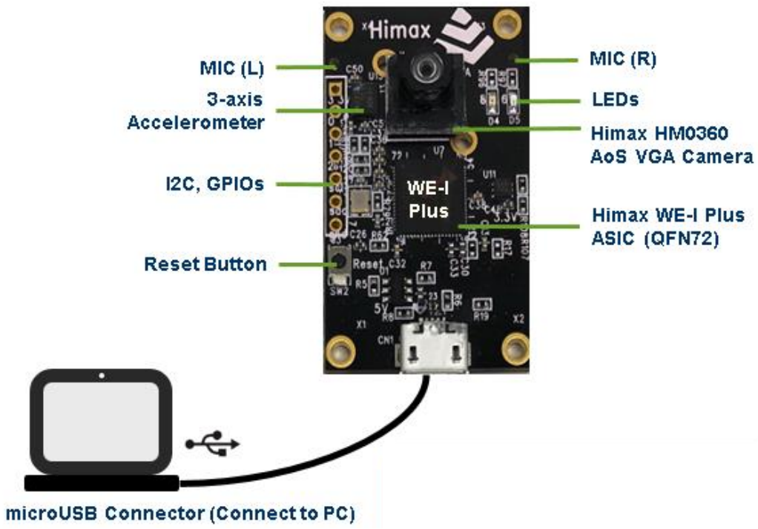
WiseEye WE-I Plus HX6537-A
Himax WE-I Plus ASIC
HX6537-A processor to accelerate NN
Feature
Low power
Hight Performance
Support Google TensorFlow Lite

Slide 21
WiseEye WE-I Plus HX6537-A - Specification
WE-I Plus ASIC (HX6537-A)
ARC 32-bit EM9D DSP with FPU
400MHz clock frequency
2MB SRAM
2MB Flash
On board
Himax HM0360 AoS TM ultra-low power VGA CCM
FTDI USB to SPI/I2C/UART bridge
LDO power supply (3.3/2.8/1.8/1.2V)
3-asix accelerometer
1x reset button
2x microphones (L/R)
2x user LEDs
microUSB connector

Slide 22
Bluetooth Low Energy 4.0
Bluetooth Low Energy is a bluetooth protocol, which is created in a low energy consumption mode by Nokia
Features:
Low power
Use GATT protocol for various applications
2.4GHz for bandwidth
Notes:
藍芽低供耗協定是Nokia公司在2004年發表的傳輸技術，這項技術被發明的原因是為了降低使用上的電力損耗(簡單來說就是為了省電)
這裡簡述一下這項協定的最大特色，顧名思義，相較其他藍芽協定，藍芽低供耗由於在使用期間能量消耗較小，因此使用時有更久的持續力，第二個特色就是藍芽低供耗有相當多領域的應用，那這些應用的規範則是透過GATT框架來幫忙定義，最後則是這個協定有2.4G的頻寬

Slide 23
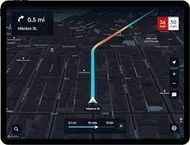
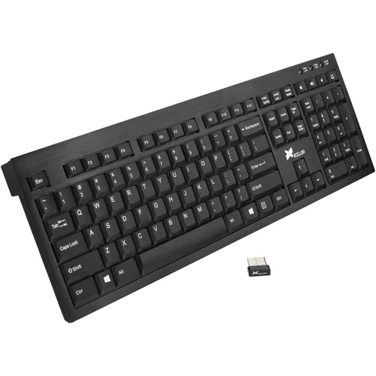

Bluetooth Low Energy 4.0
Application
All of application use the GATT profile
Blood Pressure
Navigation
HID connect
Notes:
這邊我找了一些藍芽低供耗常見的應用，同樣的，這些應用都有使用GATT profile 來規定你使用的device在這些情境要有怎麼工作。
在健康護理規範中，常見的應用有血壓量測、血糖監測。而在運動方面GATT profile也提供了運動心律和位置定位(有些人會習慣到較為偏僻的地方騎單車)的相關規範。在最後的HID connect中則是定義了各種裝置，如無線滑鼠、無線鍵盤要如何和Server做傳輸，而HID connect也是我們報告中，會使用到藍芽低供耗的部分。

Slide 24
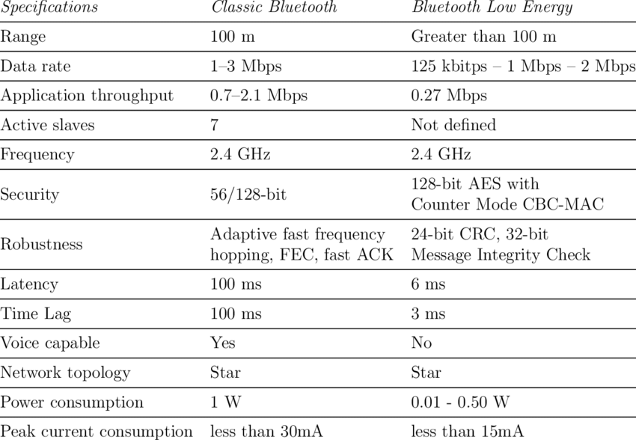
Specification
Notes:
簡述了藍芽低供耗後，這裡我提供藍芽低供耗的Specification，從這張圖我們可以知道我們使用這個協定的主要原因為(1)Delay較短和(2)功率消耗較小。由於我們的產品是為了幫助駕駛能在行駛過程有意外或變動時加以提醒，因此在訊息傳遞時要盡量做到即時提醒，使用上的話也要保證在行駛過程中，產品的工作不能被中斷。由上述原因，我們可以了解降低Delay和消耗功率對於我們的產品是否安全是相當重要的指標。另外，無須額外透過傳輸線傳遞資料也是我們選擇藍芽低供耗的原因之一。

Slide 25
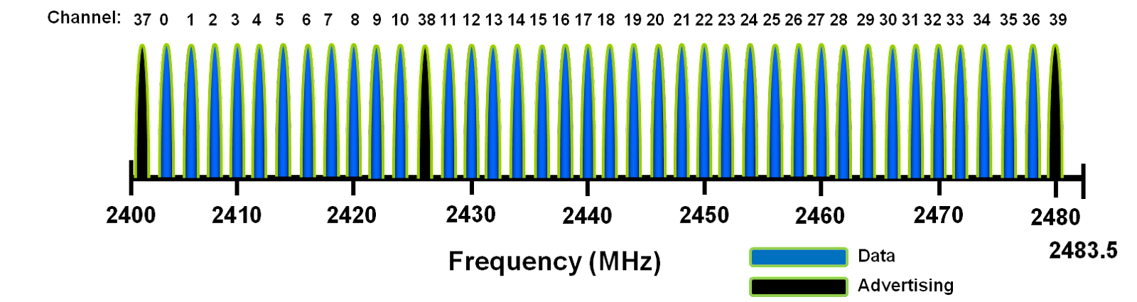
Bandwidth
Diviede into 40 channels for each 2 GHz
Notes:
在頻寬上，藍芽低供耗的總頻寬為大約2.4GHz，並且在這段訊號切成40個頻寬為2G的channel。那我補充一下，在展頻的部分，藍芽低供耗使用跳頻來完成。

Slide 26
GATT (Generic Attribute Profile)
Two mayor characteristics
GATT Server
GATT Client
Framework of GATT: ATT protocol (Attribute protocol)
Define the realtionship between GATT Server and GATT Client
Request the data of APK and attriute during the connection
Bound the same type of servie into one service
Notes:
那麼，在介紹報告要用的HID connect之前，我先簡單提一下GATT是怎麼運作的。GATT profile的框架式ATT protocol，全名又叫做Attribute protocol，ATT protocol的主要功能為(1)定義GATT server和GATT client (2)在Server和Client連接期間，向雙方要求自身的詳細資料，包括各自連接時所需的參數和APK的資料型態 (3) 將GATT profile中不同種的服務綁在一起，舉例來說，在GATT的健康護理profile中，血糖監測和血壓監測會被歸類在同一個profile。

Slide 27
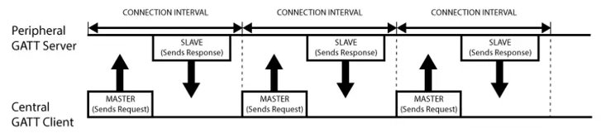
Connection of GATT
Notes:
上面的圖表示了GATT server和GATT連線時的互動。GATT Client表示傳送資料到Server的裝置，而GATT Server則是接收來自GATT Client資料的一方。當雙方尚未建立連線時，Server就會廣播自己的位址給Client，如果廣播被Client接收到的話，那Client就會回傳一個包含自己屬性的資料給Server，這個屬性通常用一個16 bits 或128 bits的 數位資料進行表示，此外屬性通常包含了Client的property，例如Client是要讀取資料還是傳遞資料給Server等等。

Slide 28
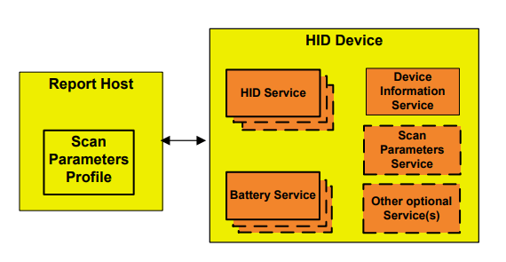
HID (Human Interface Devices)
Used to connect peripheral device on this report
One of GATT profile
Provides the wireless connection with longer usage time
Wireless mouse, wireless keyboard...
Notes:
介紹完GATT，那這邊就要提及一下GATT profile 中的HID connection。在HID profile中，收到HID data的一方被定義HID host，同樣的，傳送資料的一方則定義為HID Client，通常是指HID Device。以我們常用的無線滑鼠為例，收到來自滑鼠資料的筆電會是HID Host，而滑鼠本身則是HID Device。這個profile最方便的地方在於導線的連接數。

Slide 29
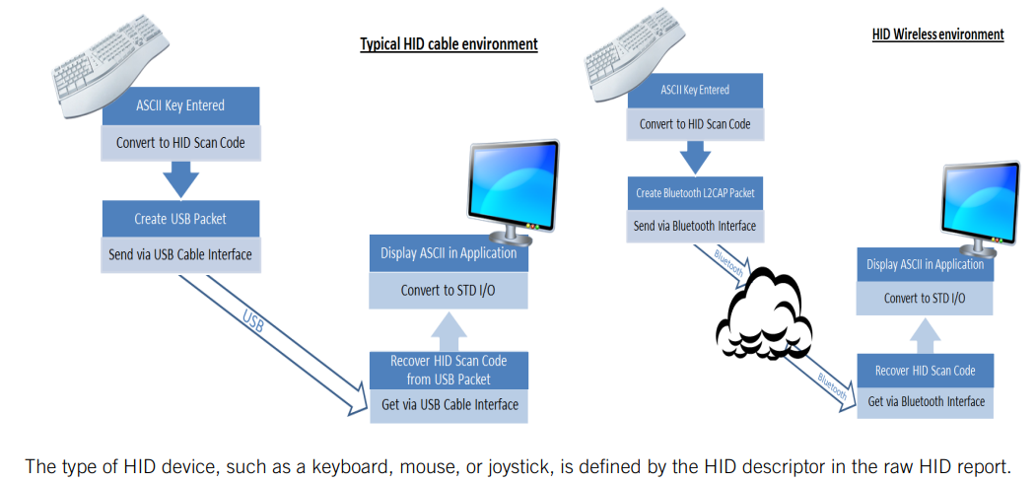
Notes:
上面的圖片是傳統HID cable環境和HID wireless環境的對比圖。從圖片可以發現周邊裝置僅需一顆無限的USB就可以在一定距離下和Server溝通，相對的傳統的HID需要額外一條USB Cable才可以傳遞資料到Server做處理。

Slide 30
Outline
Introduction
Motivations
System Architecture
Technology
Global Market Analysis
SWOT Analysis
Porter’s 5 Forces Analysis
Reference

Slide 31
Global Market Analysis
Market Forecast
ADAS market was valued at $23.44 billion in 2021
It is expected to reach a value of $75.27 billion by 2030
Therefore, it has an extraordinary compound annual growth rate (CAGR) of 13.83%
Two key factors of the market growth
The increase in disposable income levels among consumers
According to a study by the US Bureau of Economic Analysis
The stricter enforcement of transportation regulations by authorities around the world
In 2020, the US Congress requires the use of Lane departure warning system (LDWS) and automatic emergency braking (AEB) in commercial trucks
Notes:
一、我們查到 2021 年時 ADAS 市場市值約為 234 億美金，而根據某個戰略市場研究報告 (strategic market research report) 的內容，他們預估到了2030年市值會成長到752億美金，換算下來可以得到極佳的 13.83% 複合年均成長率 二、同樣根據戰略市場研究報告 (strategic market research report) 的內容，促成 ADAS 市場增長的兩個主要因素: (1) 消費者可支配收入的增加 以及 (2) 世界各地政府當局的運輸法規變嚴格。 關於於第一點，根據美國經濟分析局的一項研究，隨著消費者可支配收入水平的提高，他們更有可能購買 ADAS 系統等專業產品。 而第二點，為了減少車輛事故的數量和由此造成的生命損失，世界各地的交通當局已經開始實施更嚴格的關於使用 ADAS 等相關產品的法規。如此一來更有助於車商或設備商推廣ADAS系統。 例如美國於 2020 年在國會通過立法，要求商用卡車在兩年內使用車道輔助技術 (lane-assist technology) 也可以稱作車道偏離警示系統 Lane departure warning system (LDWS) 和 自動緊急煞車 (automatic emergency braking)。

Slide 32
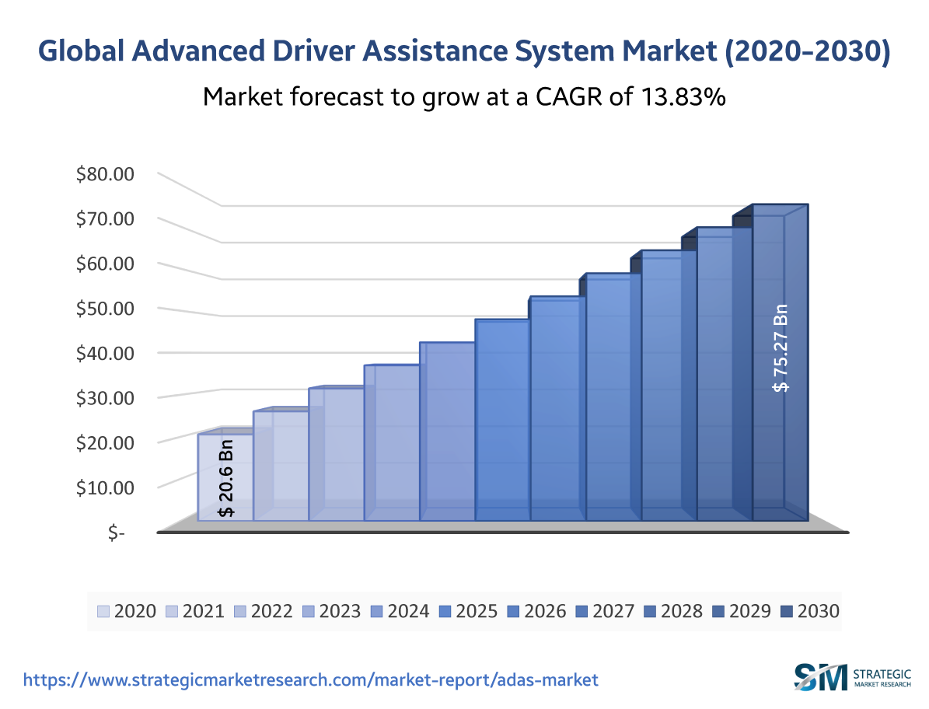
Global Market Analysis
Notes:
2020年市值 206 億美金，2021 年時 ADAS 市場市值約為 234 億美金，預估到了2030年市值會成長到752億美金，換算下來可以得到極佳的 13.83% 複合年均成長率 (compound annual growth rate, CAGR)

Slide 33
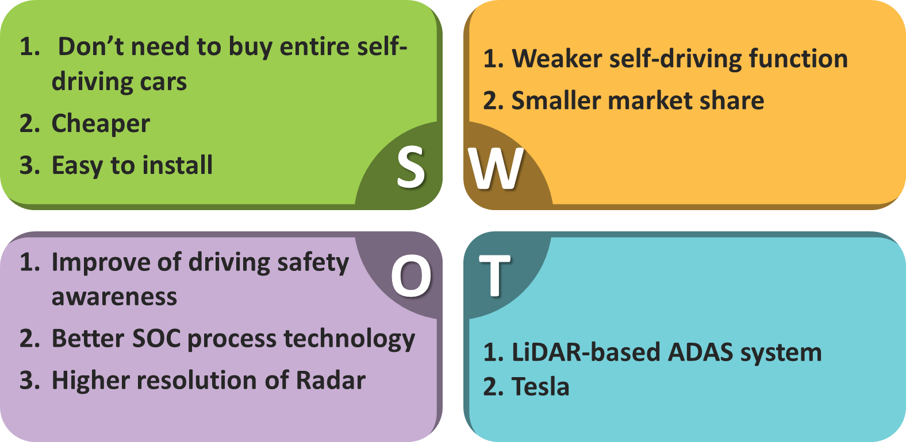
SWOT Analysis

Slide 34
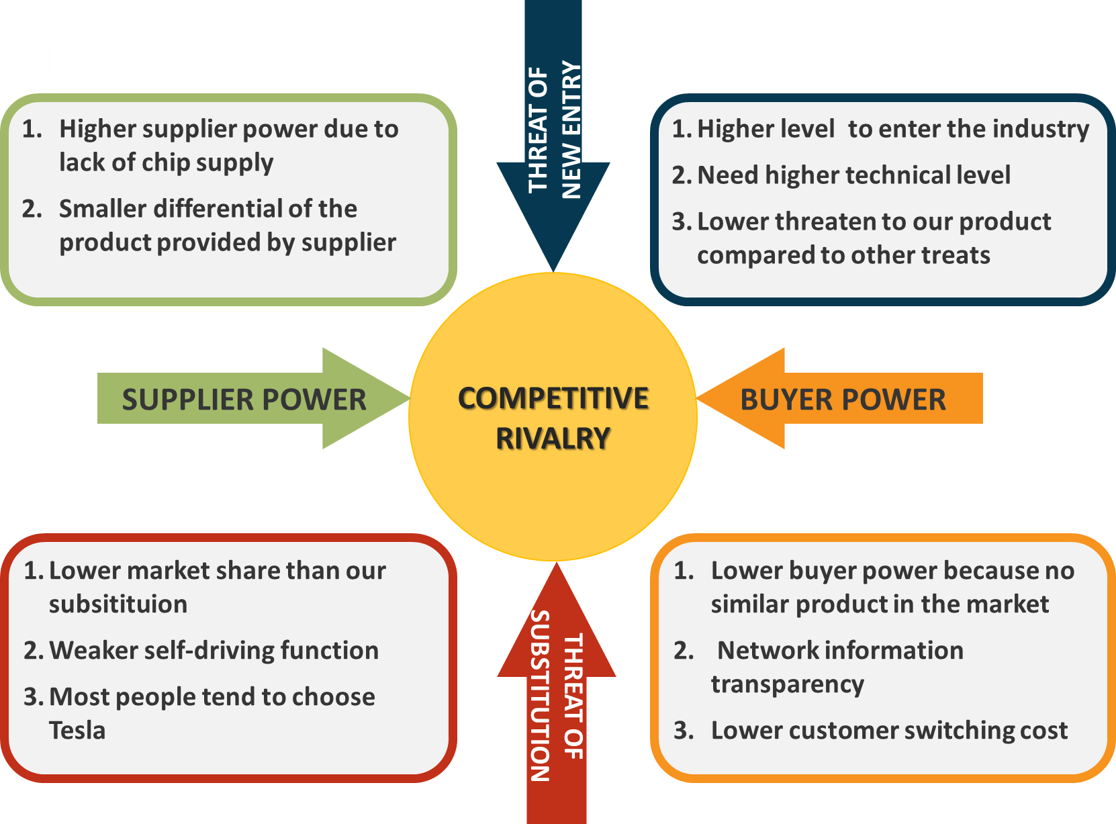
Porter’s 5 Forces Analysis

Slide 35
Outline
Introduction
Motivations
System Architecture
Technology
Global Market Analysis
Reference

Slide 36
Reference
[1] Gershon, Pnina, et al. "Distracted driving, visual inattention, and crash risk among teenage drivers." American journal of preventive medicine 56.4 (2019): 494-500.
[2] Ball, Karlene K., Virginia G. Wadley, and Jerri D. Edwards. "Advances in technology used to assess and retrain older drivers." Gerontechnology (2002).
[3] Tzortzi, Anna, et al. "Driving behavior that limits concentration: A nationwide survey in Greece." International journal of environmental research and public health 18.8 (2021): 4104.
[4] https://www.himax.com.tw/wp-content/uploads/2020/06/Himax-Launches-WiseEye-WE-I-Plus-HX6537-A-to-Support-AI-Deep-Learning-with-TensorFlow-Lite-for-Microcontroller_-final.pdf
[5] https://cdn.sparkfun.com/assets/1/b/b/2/1/WE-I_Plus_EVB_Technical_Document_v03.pdf
[6] Redmon, Joseph, et al. "You only look once: Unified, real-time object detection." Proceedings of the IEEE conference on computer vision and pattern recognition. 2016.
[7] Wang, Chien-Yao, Alexey Bochkovskiy, and Hong-Yuan Mark Liao. "YOLOv7: Trainable bag-of-freebies sets new state-of-the-art for real-time object detectors." arXiv preprint arXiv:2207.02696 (2022).
[8] Pan, Xingang, et al. "Spatial as deep: Spatial cnn for traffic scene understanding." Proceedings of the AAAI Conference on Artificial Intelligence. Vol. 32. No. 1. 2018.
[9] https://chih-sheng-huang821.medium.com/%E6%A9%9F%E5%99%A8-%E6%B7%B1%E5%BA%A6%E5%AD%B8%E7%BF%92-%E7%89%A9%E4%BB%B6%E5%81%B5%E6%B8%AC-non-maximum-suppression-nms-aa70c45adffa
[10] https://www.globenewswire.com/en/news-release/2022/07/20/2482868/0/en/Advanced-Driver-Assistance-Systems-ADAS-Market-Worth-USD-75-27-Billion-by-2030-With-a-CAGR-of-13-83.html

Slide 37
Reference
[11] https://www.dfrobot.com/product-2417.html
[12] https://img.dfrobot.com.cn/wiki/5b973267c87e6f19943ab3ad/ec7dd3a55ba1d58fcbd5830ee08c0e7f.pdf
[13] https://img.dfrobot.com.cn/wiki/5b973267c87e6f19943ab3ad/b5b08fe2ea631f0becdfa0c15db88c4a.pdf
[14] https://pressureprofile.com/sensors/digitacts
[15] https://cdn2.hubspot.net/hubfs/5361756/Spec%20Sheets/Spec%20Sheet_DigiTacts%20System.pdf?__hstc=57482165.7b47cad7ed79f0c6c059ea4d87fe50ad.1672817794233.1672817794233.1672820140562.2&__hssc=57482165.1.1672938130050&__hsfp=2977007349&hsCtaTracking=4427830a-a50d-4af1-b425-660de65748d0%7Cd684d85b-195b-4d34-a900-a1b2273652b7
[16] https://hackmd.io/@ShenTengTu/SkPltNmiE?type=view
[17] https://medium.com/@nalydadad/%E6%A6%82%E8%BF%B0-gatt-%E8%97%8D%E8%8A%BD%E5%82%B3%E8%BC%B8-9fa218ce6022
[18] https://ithelp.ithome.com.tw/articles/10224000
[19] https://www.ti.com.cn/cn/lit/an/swra715/swra715.pdf?ts=1656944702493
[20] https://www.2cm.com.tw/2cm/zh-tw/market/B1C12F26DAD442478C0CACF162E9D44D
[21] https://www.researchgate.net/figure/3-Comparison-of-Classic-Bluetooth-and-Bluetooth-Low-Energy-BLE-46_tbl3_341913410
[22] https://microchipdeveloper.com/wireless:ble-phy-layer
[23] https://wifivitae.com/2020/05/01/ble-overview/
[24] https://cdn.sparkfun.com/datasheets/Wireless/Bluetooth/RN-HID-User-Guide-v1.0r.pdf
[25] TI AWR 2944 EVM. Available online: https://www.ti.com/tool/AWR2944EVM (accessed on 08 January 2023)
[26] TI AWR 2944 Spec. Available online: https://www.ti.com/product/AWR2944 (accessed on 08 January 2023)
[27] MediaTek Dimensity 9200 Spec. Avaliable online: https://www.mediatek.com/products/smartphones-2/mediatek-dimensity-9200 (accessed on 08 January 2023)

Slide 38
Task Partition
We have organized our work into the following tasks
陳劭珩: System Spec and Architecture, CPU, DSP, Radar
洪子晴: Digitacts Pressure Sensor, MEMS Gas Sensor
徐瑞憫: Data Flow Diagram, Main Chip Architecture, AI accelerator, YOLOv7, SCNN
林亭君: Introduction, Global Market Analysis
鄭皓姿: Bluetooth LE 4.0, HID, SWOT Analysis and Porter’s 5 Forces Analysis
Great thanks to 瑞憫 for organizing the work, to 皓姿 for the great presentation, and to 子晴 for handling the difficult task of working with the special sensors.

Slide 39
Thanks

